Slide 1
SDLC
Senthil Natarajan
Please connect with me via below social media
Instagram: https://www.instagram.com/rba_infotech/
LinkedIn: https://www.linkedin.com/company/rba-infotech/
Facebook: https://www.facebook.com/people/RBA-Infotech/100043552406579/

Slide 2
SDLC – Software Development Life Cycle
Software Development Life Cycle (SDLC) is a framework that defines the steps involved in the development of software at each phase.
The Phases of the SDLC
Requirements Gathering & Analysis
Design
Coding / Implementation
Testing
Deployment
Maintenance

Slide 3
Requirements Gathering & Analysis
During this phase, all the relevant information is collected from the customer to develop a product as per their expectation. Any ambiguities must be resolved in this phase only.
Business analyst and Project Manager set up a meeting with the customer to gather all the information like what the customer wants to build, who will be the end-user, what is the purpose of the product. Before building a product a core understanding or knowledge of the product is very important.
For Example, A customer wants to have an application which involves money transactions. In this case, the requirement has to be clear like what kind of transactions will be done, how it will be done, in which currency it will be done, etc.
Once the requirement gathering is done, an analysis is done to check the feasibility of the development of a product. In case of any ambiguity, a call is set up for further discussion.
Once the requirement is clearly understood, the SRS (Software Requirement Specification) document is created. This document should be thoroughly understood by the developers and also should be reviewed by the customer for future reference.

Slide 4
Feasibility Study
The some of the feasibility checks done are:
Economic: Can we complete the project within the budget or not?
Operation feasibility: Can we create operations(functionality) which is expected by the client?
Technical: Need to check whether the current computer system can support the software
Schedule: Decide that the project can be completed within the given schedule or not.
Legal: Can we handle this project as cyber law and other regulatory framework/compliances.

Slide 5
Requirements Gathering Techniques
Interviews
Surveys and Questionnaires
Requirements Elicitation Techniques
Workshops and Focus Groups
Use Cases and User Stories
Observation
Prototyping
Business Process Modelling

Slide 6
Requirements Gathering Techniques
Interviews
Structured Interviews: Pre-defined questions are asked to gather specific information.
2. Unstructured Interviews: Open-ended questions are asked to gather general information.
3. Semi-structured Interviews: A combination of structured and unstructured questions are asked.
Surveys and Questionnaires
4. Online Surveys: Surveys are conducted online to gather information from a large group of people.
5. Paper-based Surveys: Surveys are conducted using paper-based questionnaires.
6. Telephone Surveys: Surveys are conducted over the phone.

Slide 7
Requirements Gathering Techniques
Requirements Elicitation Techniques
17. Brainstorming: A group of stakeholders generate a large number of ideas.
18. Mind Mapping: A visual representation of ideas and concepts.
19. SWOT Analysis: Identifies strengths, weaknesses, opportunities, and threats.
20. Decision Tables: A table that shows the possible conditions and actions.
Workshops and Focus Groups
9. Joint Application Development (JAD) Workshops: Stakeholders and developers work together to gather requirements.
10. Focus Groups: A small group of stakeholders discuss and provide feedback on requirements.

Slide 8
Requirements Gathering Techniques
Use Cases and User Stories
13. Use Cases: A description of the system's behavior from the user's perspective.
14. User Stories: A natural-language description of the system's behavior from the user's perspective.
Prototyping
11. Throwaway Prototyping: A prototype is created to gather requirements and then discarded.
12. Evolutionary Prototyping: A prototype is created and refined based on stakeholder feedback.

Slide 9
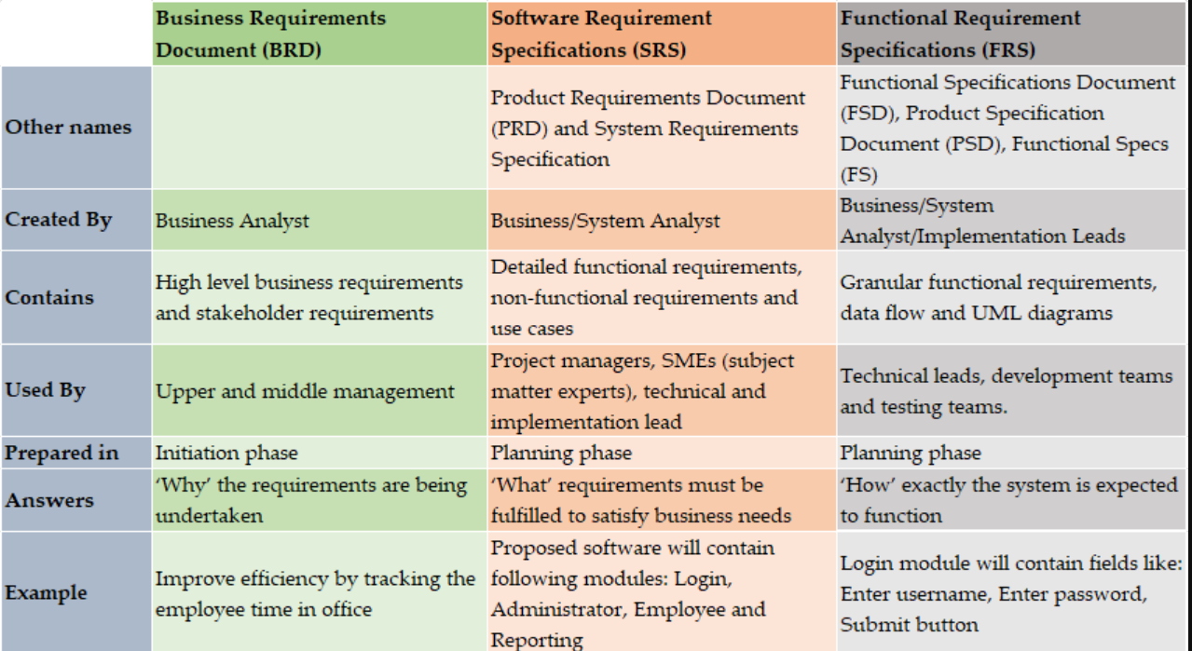
BRD vs SRS vs FRS

Slide 10
Stakeholders in a Project
Some of the typical key project stakeholders you'll find in a project include:
Customers: The direct user of a product or service, often both internal and external to the company executing the project
Project manager: The project's leader
Project team members: The group executing the project under the project manager's leadership
Project sponsor: The project's financier
Steering committee: An advisory group providing guidance on key decisions, which includes the sponsor, executives, and key stakeholders from the organization
Executives: The top management in the company executing the project; those who direct the organization's strategy
Resource managers: Other managers who control resources needed for executing the project

Slide 11
Design
In this phase, the system and software design documents are prepared as per the requirement specification document. This helps define overall system architecture. This design phase serves as input for the next phase of the model.
There are two kinds of design documents developed in this phase:
High-Level Design (HLD)
Define Overall System Architecture of the application
Brief description and name of each module
An outline about the functionality of every module
Database tables identified along with their key elements
Complete architecture diagrams along with technology details
Low-Level Design(LLD)
Functional logic of the modules
Database tables, which include type and size
Complete detail of the User interface Design
Complete details of the User Experience Design
Addresses all types of dependency issues
Listing of error messages
Complete input and outputs for every module

Slide 12
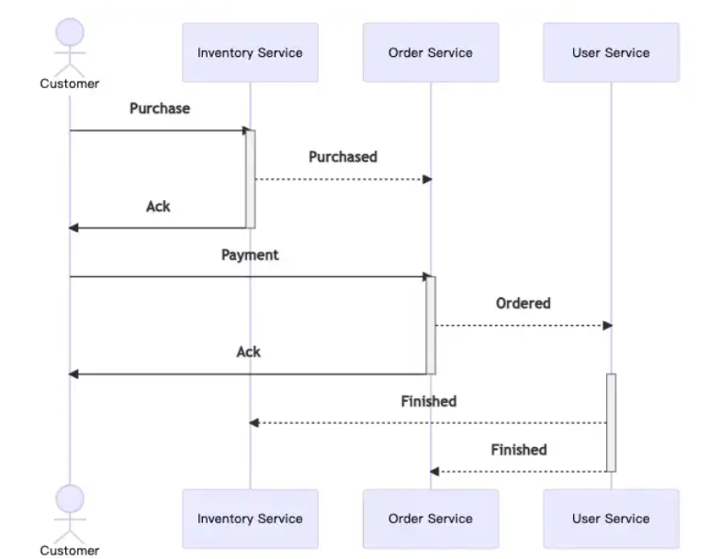
High Level Design of Ecommerce Application

Slide 13
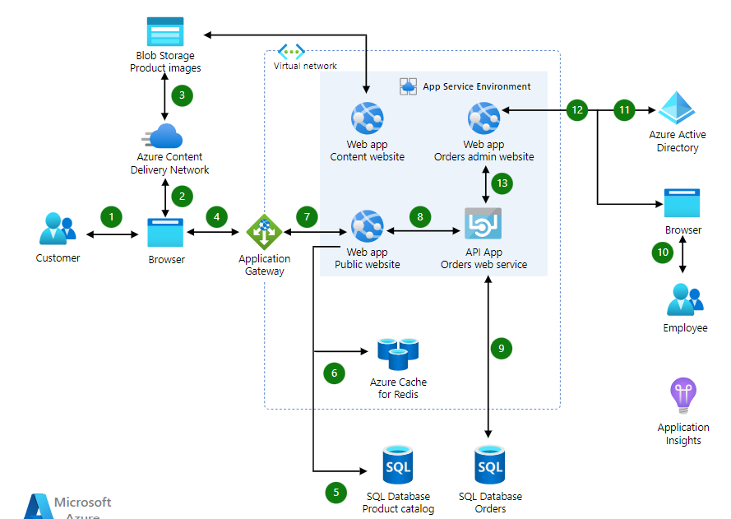
Another Example

Slide 14
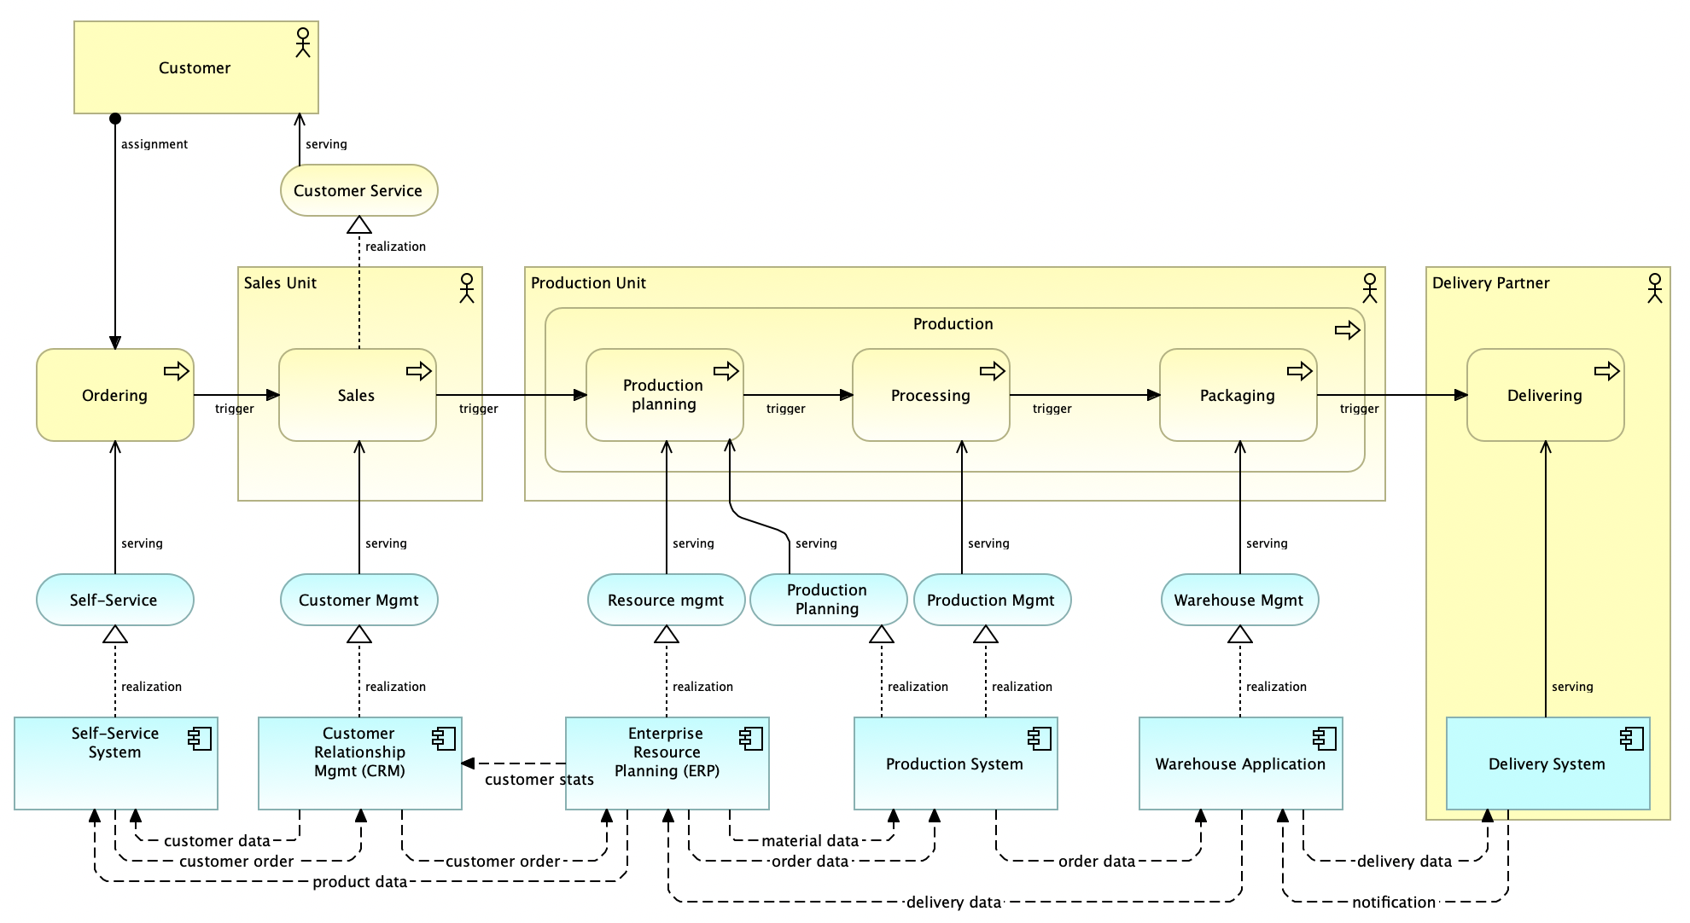
Sample Low Level Design Doc

Slide 15
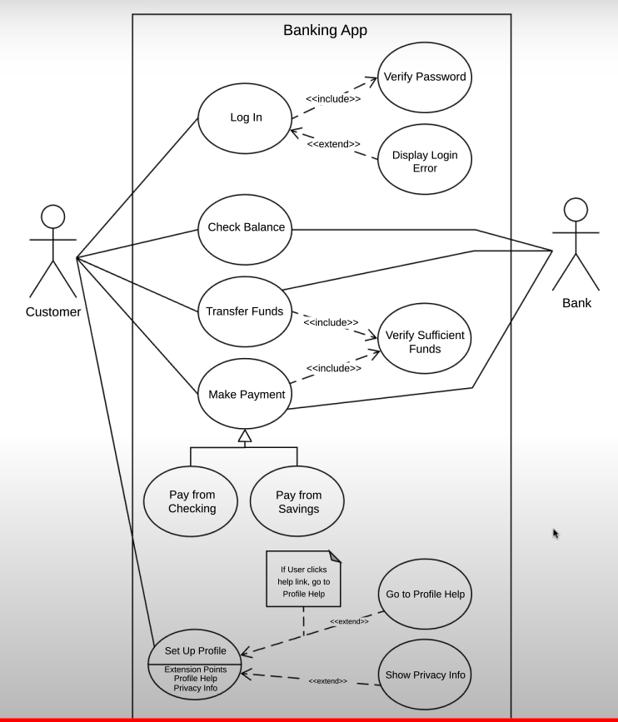
Use Case Diagram (UML)

Slide 16
Coding
Once the system design phase is over, the next phase is coding. In this phase, developers start build the entire system by writing code using the chosen programming language. In the coding phase, tasks are divided into units or modules and assigned to the various developers. It is the longest phase of the Software Development Life Cycle process.
In this phase, Developer needs to follow certain predefined coding guidelines. They also need to use programming tools like compiler, interpreters, debugger to generate and implement the code.
The code is developed and verified if it is working as per the requirement in the Development Environment.

Slide 17
Testing
Testing starts once the coding is complete and the modules are released for testing. In this phase, the developed software is tested thoroughly and any defects found are assigned to developers to get them fixed.
Retesting, regression testing is done until the point at which the software is as per the customer’s expectation. Testers refer SRS document to make sure that the software is as per the customer’s standard.

Slide 18
Deployment
Once the product is tested, it is deployed in the production environment or first UAT (User Acceptance testing) is done depending on the customer expectation.
In the case of UAT, a replica of the production environment is created and the customer along with the developers does the testing. If the customer finds the application as expected, then sign off is provided by the customer to go live.

Slide 19
Maintenance
Once the system is deployed, and customers start using the developed system, following 3 activities occur
Bug fixing - bugs are reported because of some scenarios which are not tested properly
Upgrade - Upgrading the application to the newer versions of the Software
Enhancement - Adding some new features into the existing software
The main focus of this SDLC phase is to ensure that needs continue to be met and that the system continues to perform as per the specification mentioned in the first phase.

Slide 20
Different SDLC Models

Slide 21
SDLC Models
Waterfall Model
V-Shape Model
Prototype Model
Iterative Model
Spiral Model
Rapid Application Development (RAD)
Agile Model

Slide 22
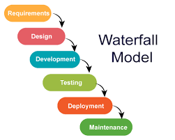
Waterfall Model

Slide 23
When Should You Use It ?
Requirements are clear and fixed that may not change.
There are no ambiguous requirements (no confusion).
It is good to use this model when the technology is well understood.
The project is small and cost is low.
Risk is zero or minimum.

Slide 24
Advantages
It is simple and easy to understand and use.
It is easy to manage.
It works well for smaller and low budget projects where requirements are very well understood.
Clearly defined stages and well understood.
It is easy to arrange tasks.
Process and results are well documented.

Slide 25
Disadvantages
Cannot accommodate changing requirements
No working software is produced until late during the life cycle.
It is difficult to measure progress within stages.
Poor model for long and ongoing projects.
High amounts of risk and uncertainty.
Not a good model for long and object oriented projects.

Slide 26
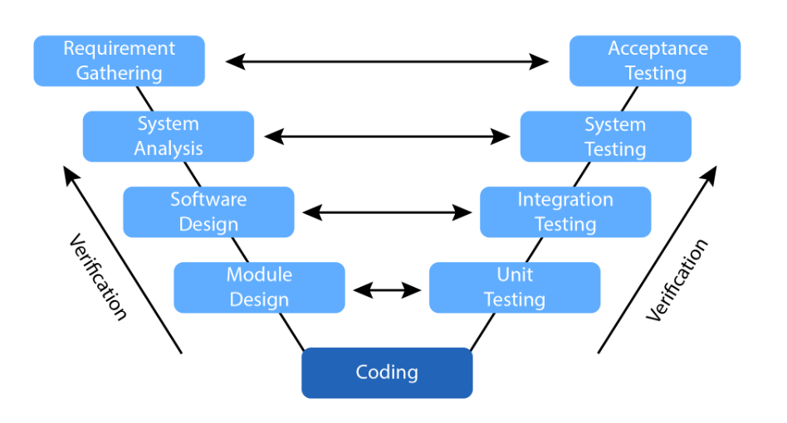
V Model
Validation

Slide 27
When to use V Model?
Excellent choice for systems requiring high reliability – hospital patient control applications
All requirements are known up-front
When it can be modified to handle changing requirements beyond analysis phase
Solution and technology are known

Slide 28
Advantages
Simple and easy to use.
Testing activities like planning, test designing happens well before coding. This saves a lot of time. Hence higher chance of success over the waterfall model.
Proactive defect tracking – that is defects are found at early stage.
Avoids the downward flow of the defects.
Works well for small projects where requirements are easily understood.

Slide 29
Disadvantages
The risk is high and unpredictable.
Software is developed during the implementation phase, so no early prototypes of the software are produced.
If any changes happen in midway, then the test documents along with requirement documents has to be updated.

Slide 30
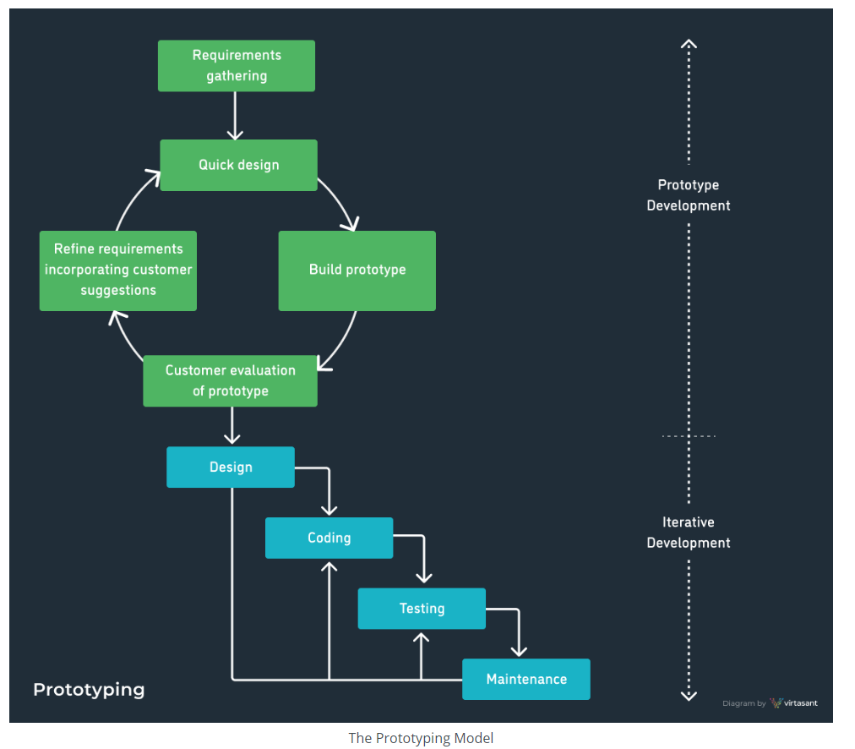
Prototype Model

Slide 31
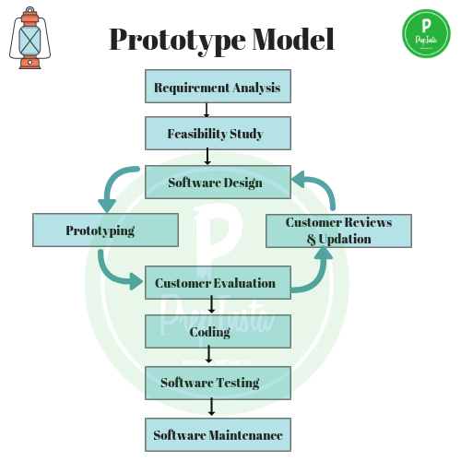
Prototype Model

Slide 32
Advantages & Disadvantages
Advantages:
Customer can see steady changes
This is useful when the requirements are changing rapidly
Disadvantages:
It is impossible to know how long it will take
There is no way to know the no of iterations will be required

Slide 33
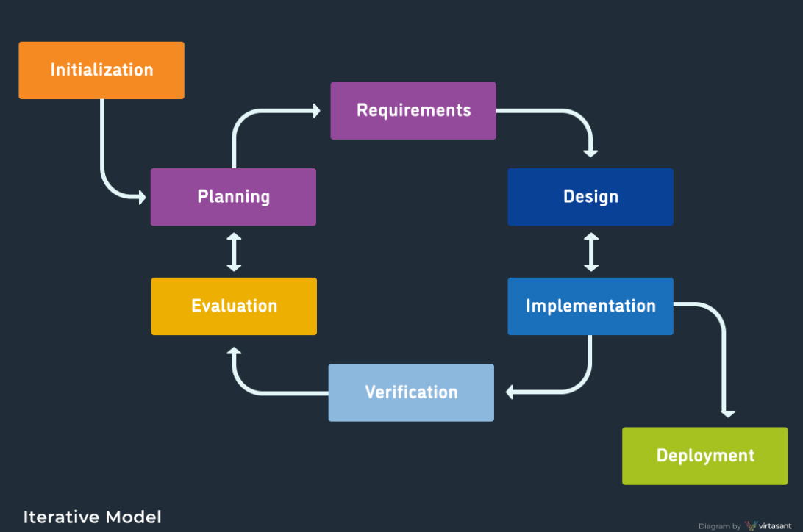
Iterative Model

Slide 34
Advantages & Disadvantages
Advantages | Disadvantages
The software will be generated quickly during the software life cycle | It requires a good planning designing
It is flexible and less expensive to change requirements and scope | Problems might cause due to system architecture as such not all requirements collected up front for the entire software lifecycle
Throughout the development stages changes can be done | Each iteration phase is rigid and does not overlap each other
This model is less costly compared to others | Rectifying a problem in one unit requires correction in all the units and consumes a lot of time
A customer can respond to each building
Errors are easy to be identified

Slide 35
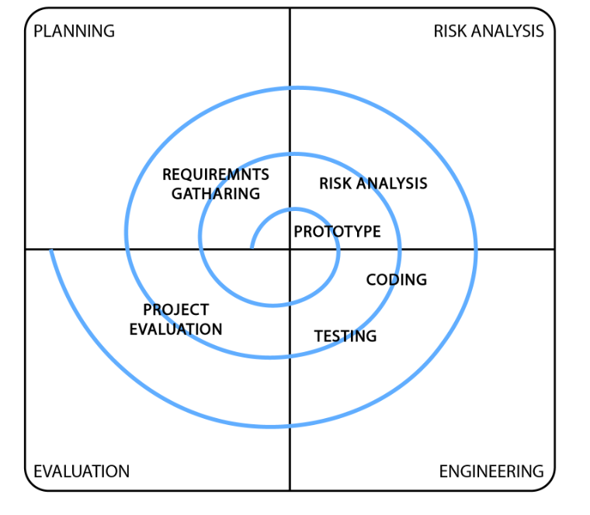
Spiral Model

Slide 36
Various Risks in Project
Cost Risk
Schedule Risk
Performance Risk
Operational Risk
Market Risk
Governance Risk
Legal Risk

Slide 37
Spiral Model Contd…
It is the combination of Water fall model & Iterative model
Each phase in spiral model begins with design goal & ends with client reviewing
Software is developed in a series of incremental releases.

Slide 38
When to use Spiral Model?
When risk & cost evaluation is important
For medium to high risk projects
When project is large and mission critical
When releases are required to be frequent
When requirements are unclear & complex
When changes may require at any time

Slide 39
Advantages & Disadvantages
Advantages
Disadvantages
Additional functionality or changes can be done at later stage
Cost estimation becomes easy as the prototype building is done in small fragments
Development is fast & features are added in a systematic way
There is always space for customer feedback.
Risk of not meeting the schedule or budget
Spiral development works best for large projects only also demands risk assessment expertise
Documentation is more as it has intermediate phase
It is not advisable for smaller projects, it might cost them a lot

Slide 40
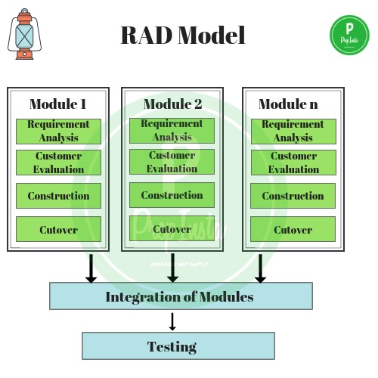
RAD Model

Slide 41
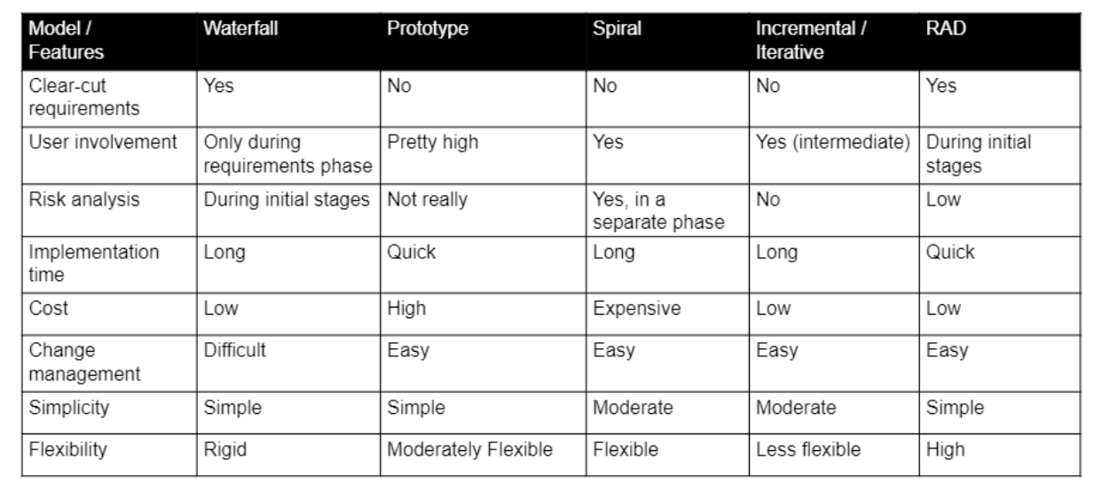
Comparison of various SDLC Model

Slide 42
Agile Methodology

Slide 43
What is Agile Methodology
Agile Methodology is a practice that promotes continuous iteration of Incremental development and testing throughout the software development lifecycle of the project.

Slide 44
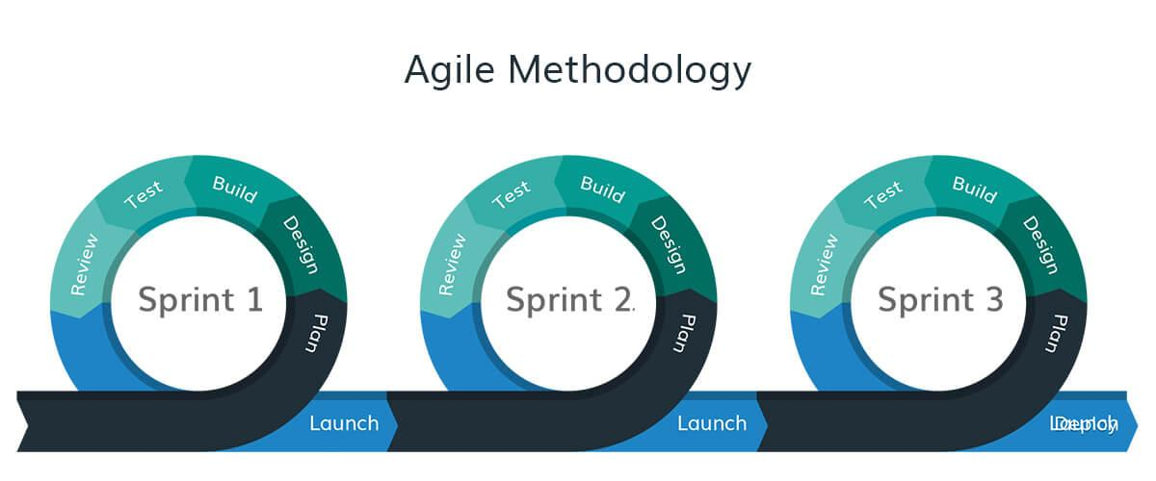
What is Agile Methodology

Slide 45
Why Agile?
Higher Customer Satisfaction
Flexibility and Adaptivity to accept changes
Better Quality
Better Productivity

Slide 46
Different Agile Methodologies
Scrum
Kanban
Extreme Programming (XP)
Lean
Crystal Methodologies
Dynamic Software Development Method
Features Driven Deployment

Slide 47
When to use Agile
Agile is preferred over traditional models of software development, like waterfall, if the project has any of the following characteristics:
Lack of clearly defined requirements due to:
  high degree of complexity of the required software system (E.g.: Unique Identification System for a country's citizens)
  high degree of novelty i.e.- a completely new idea for a software without any precursors as reference (E.g.: Engine control system of a self-driving car)
Aggressive deadlines

Slide 48
Agile Scrum Overview
Issues
Ceremony / Stage / Events
Artifacts
Roles
Backlogs
Product Owner
Epic
Burn Up Chart
Product Backlog
Release Planning
User Story
Burn Down Chart
Sprint Backlog
Sprint Planning
Scrum Master
Bug
Velocity Chart
Daily Scrum
Dev Team (Dev + Tester)
Task
Sprint Review
Sprint Retrospective
DoR
Story Points
DoD

Slide 49
Agile Manifesto: Principles
The 4 values of Agile are:
Individuals and Interactions Over Processes and Tools
Working Software Over Comprehensive Documentation
Customer Collaboration Over Contract Negotiation
Responding to Change Over Following a Plan

Slide 50
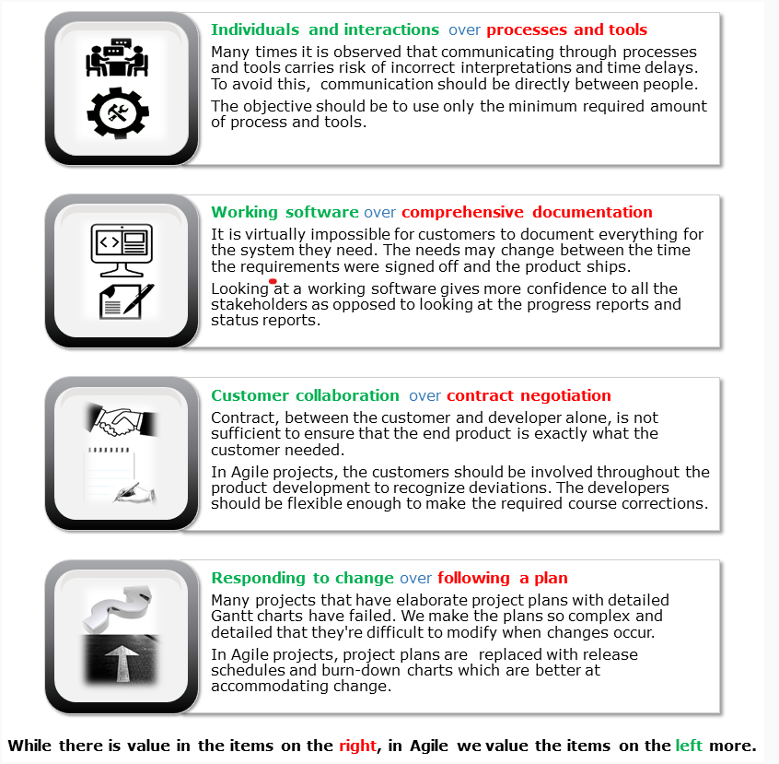
Agile Manifesto

Slide 51
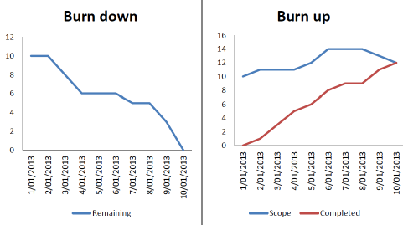
Burn Up and Burn Down Chart

Slide 52
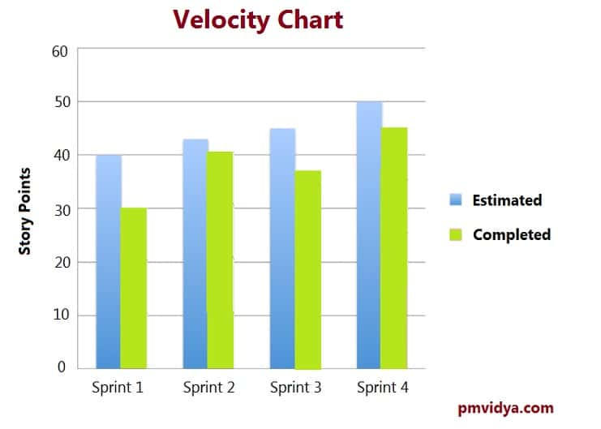
Velocity Chart

Slide 53
SCRUM
What is Scrum
SCRUM is an agile development method which concentrates specifically on how to manage tasks within a team-based development environment. Basically, Scrum is derived from activity that occurs during a rugby match. Scrum believes in empowering the development team and advocates working in small teams (say- 7 to 9 members).
It consists of three roles, and their responsibilities are explained
Product Owner
Scrum Master
Scrum Team

Slide 54
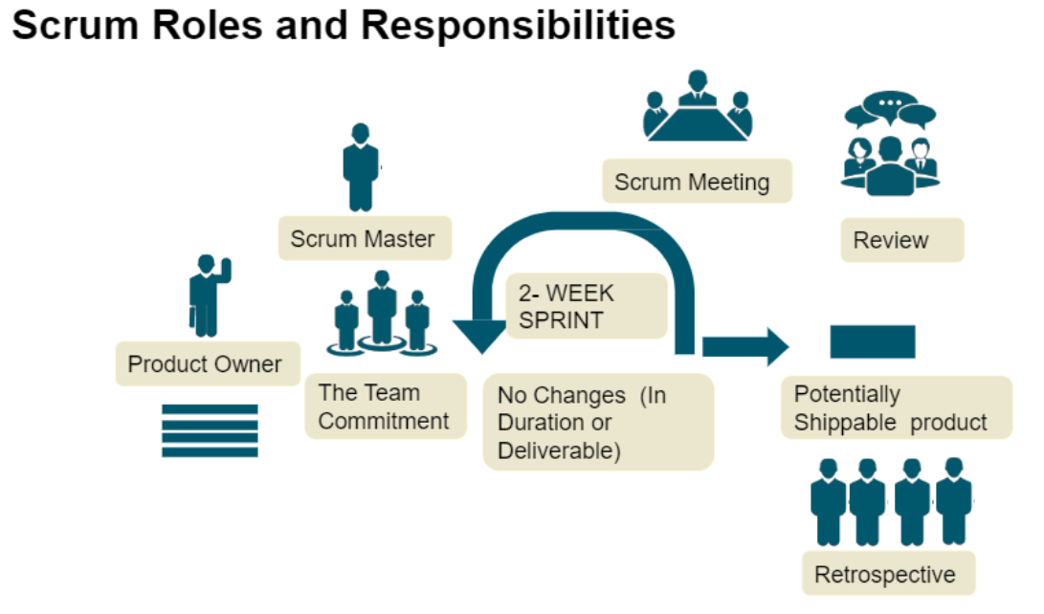
Agile / Scrum Team

Slide 55
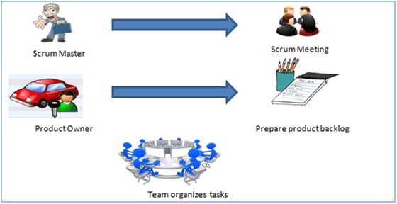
SCRUM

Slide 56
SCRUM
Scrum Master
  Master is responsible for setting up the team, sprint meeting and removes obstacles to progress
Product owner
  The Product Owner creates product backlog, prioritizes the backlog and is responsible for the delivery of the functionality at each iteration
Scrum Team
  Team manages its own work and organizes the work to complete the sprint or cycle

Slide 57
Process Flow of SCRUM
Process flow of scrum testing is as follows:
Each iteration of a scrum is known as Sprint
Product backlog is a list where all details are entered to get the end-product
During each Sprint, top user stories of Product backlog are selected and turned into Sprint backlog
Team works on the defined sprint backlog
Team checks for the daily work
At the end of the sprint, team delivers product functionality

Slide 58
Responsibility of Product Owner
Drives the product from business perspective.
Responsibilities.
  To create the Product Backlog
  To define the user stories and prioritize their values
  To determine the release date and contents
  To take an active role in release planning and sprint planning meetings
  To monitor and track that team is working on the most valued requirement
  To represent the voice of the customer
  To move the requirement to sprint (DoR – Definition of Ready) and accept the user stories which meets the definition of done (DoD) and defined acceptance criteria.

Slide 59
DoR and DoD
DoR (Definition of Read)
The user stories coming into sprint is called Definition of Ready
Definition of Done
The product coming out of the sprint is called Definition of Done

Slide 60
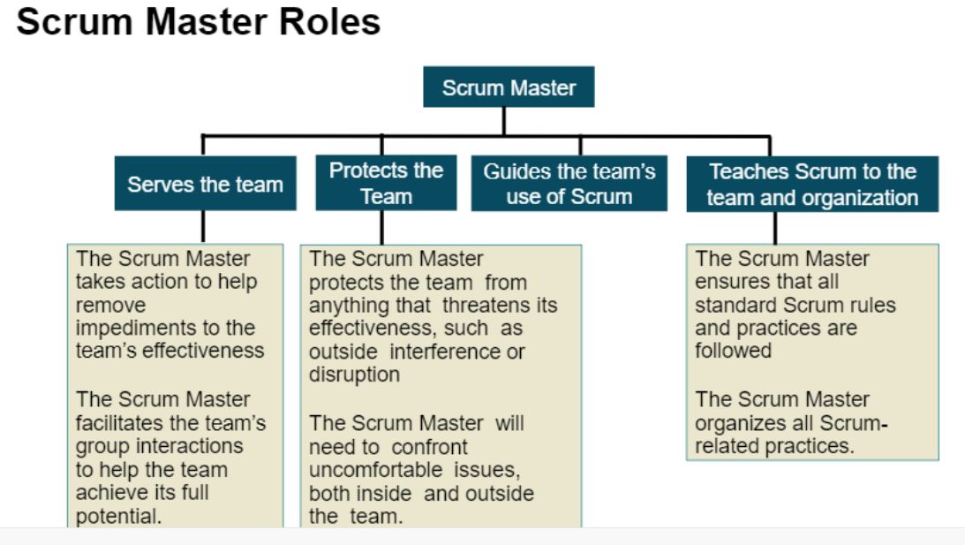
Responsibility of Scrum Master

Slide 61
Responsibility of Scrum Master
Facilitator of team who helps them to follow agile practices so that they can meet their commitments.
Responsibilities.
  To enable close co-operation between all roles and functions.
  To remove any blocks.
  To shield team from any disturbance.
  To work with the organization to track progress and processes of company.
  To ensure that Agile inspect & Adapt process are leveraged properly which includes.
    Scrum Meeting / Daily stand up calls
    Review
    Retrospective meetings
    Other Planned meetings
To facilitate team meetings and decision making process.

Slide 62
Responsibility of Development Team
Provide effort estimates of the items in the product backlog.
Negotiate the sprint goal with the product owner.
Design, code, and test the increment daily.

Slide 63
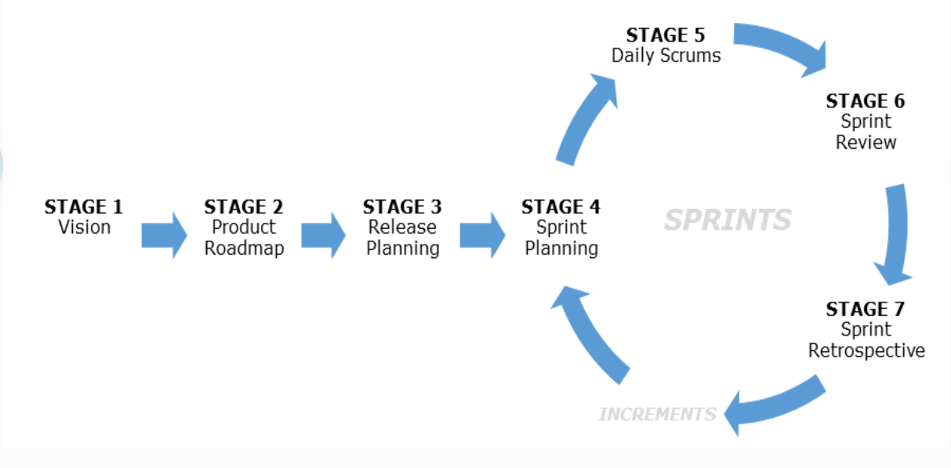
Scrum Stages / Events

Slide 64
Scrum Events
Sprint: Iterative time boxes where a goal is accomplished. Time frame does not exceed one calendar month and are consistent throughout the development process.
Sprint planning: Where the entire Scrum team get together — at the beginning of every Sprint — to plan the upcoming sprint.
Scrum Meeting / Daily Scrum : 15 minute time boxed meeting held at the same time, every day of the Sprint, where the previous day’s achievements are discussed, as well as the expectations for the following one.
Sprint review: An meeting held at the end of every Sprint where the Scrum team present their Increment to the stakeholders, and discuss feedback.
Sprint retrospective: A meeting where the Scrum team reflect on the proceedings of the previous Sprint and establish improvements for the next Sprint.

Slide 65
Scrum Artifacts
Product backlog: Managed by the Product Owner, it’s where all the requirements needed for a viable product are listed in order of priority. Includes features, functions, requirements, enhancements, and fixes that authorize any changes to be made to the product in future releases.
Sprint backlog: A list of the tasks and requirements that need to be accomplished during the next Sprint. Sometimes accompanied by a Scrum task board, which is used to visualize the progress of the tasks in the current Sprint, and any changes that are made in a ‘To Do, Doing, and Done’ format.
Burn-up charts represent how much work has been completed in the project
Burn-down chart represents the remaining work in a project.
User Stories: User Stories defines the actual business requirement. Generally created by Product owner.
Epic: A group of related user stories is called an Epic.
Task: To accomplish the business requirements Development Team and Testing Team create tasks.
Increment: The sum of all the product backlog items completed in every sprint.

Slide 66
Scrum Artifacts
Task board is dash board which shows progress of the project. It contains:
    User Story: which has the actual business requirement.
    To Do: Tasks that can be worked on.
    In Progress: Tasks in progress.
    Done: Completed tasks.
Daily stand up meeting is essential for any team in which-
    Team discuss about how much work has been completed.
    What are the plans to resolve technical issues.
    What steps need to done to complete the projects etc.

Slide 67
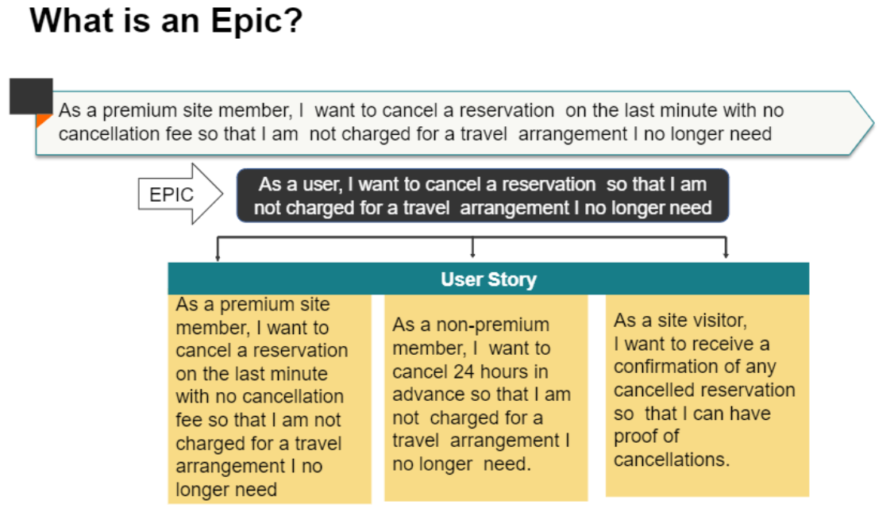
Scrum Artifacts

Slide 68
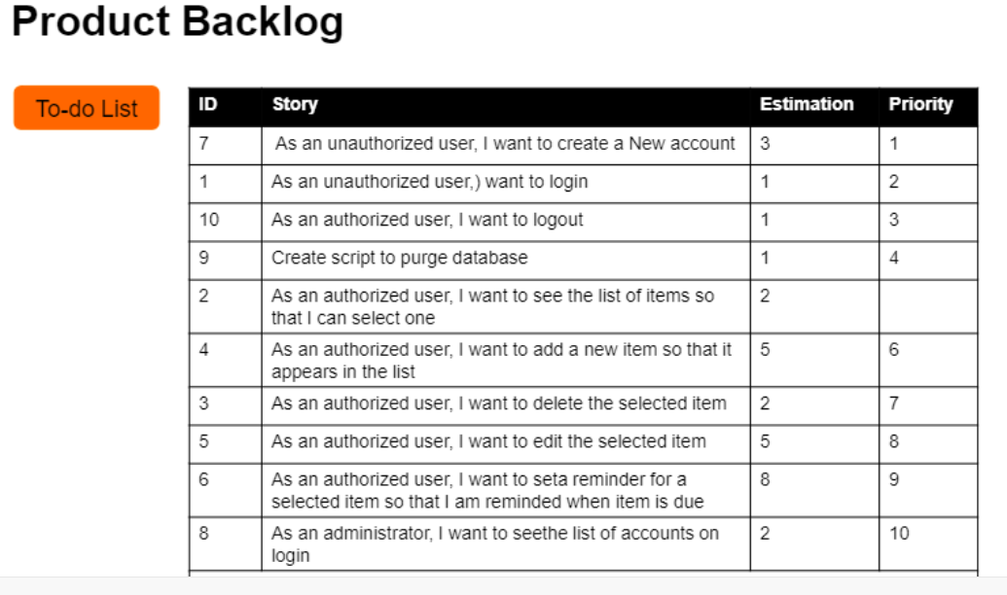
Scrum Artifacts

Slide 69
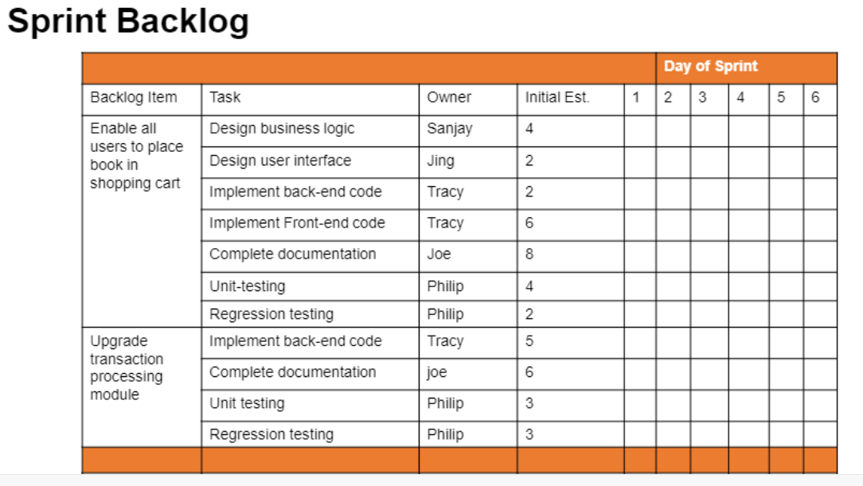
Scrum Artifacts

Slide 70
Waterfall vs Agile
Waterfall | Agile
Development of the software flows sequentially from start point to end point. | Agile method proposes incremental and iterative approach to software design
The customer can only see the product at the end of the project | The customer has early and frequent opportunities to look at the product and make decision and changes to the project
Testers work separately from developers | Testers and developers work together
The design process is not broken into an individual models | The agile process is broken into individual models that designers work on
Waterfall model are more secure because they are so plan oriented | Agile model is considered unstructured compared to the waterfall model
Only after the development, the whole product is tested. If the requirement error is found or any changes have to be made, the project has to start from the beginning | Error can be fixed in the middle of the project

Slide 71
Waterfall vs Agile
Waterfall | Agile
The development process is phased, and the phase is much bigger than iteration. Every phase ends with the detailed description of the next phase. | Development process is iterative, and the project is executed in short (2-4) weeks iterations. Planning is very less.
Only after the development phase, the testing phase is executed because separate parts are not fully functional. | Every iteration has its own testing phase. It allows implementing regression testing every time new functions or logic are released.
User acceptance is performed at the end of the project. | At the end of every sprint, user acceptance is performed
All features developed are delivered at once after the long implementation phase. | In agile testing when an iteration end, shippable features of the product is delivered to the customer. New features are usable right after shipment. It is useful when you have good contact with customers.
All sorts of project can be estimated and completed. | Small projects can be implemented very quickly. For large projects, it is difficult to estimate the development time.

Slide 72
The 12 Principles of Agile
There are 12 Agile principles:
Our highest priority is to satisfy the customer through early and continuous delivery of valuable software.
Welcome changing requirements, even late in development. Agile processes harness change for customer’s competitive advantage.
Deliver working software frequently, from a couple of weeks to a couple of months, with a preference to the shorter timescale.
Business people and developer must work together daily throughout the project.
Build projects around motivated individuals. Give them the environment and support they need, and trust them to get the job done.
The most efficient and effective method of conveying information to and within the development team is face-to-face conversation.

Slide 73
Agile Principles Contd…
Working software is primary measure of progress. A software is not finished when it is successfully tested and delivered. It is finished when it is tested and accepted by end user.
Agile processes promote sustainable development. The sponsors, developers and users should be able to maintain a constant pace indefinitely.
Continuous attention to technical excellence and good design enhances the agility.
Simplicity – the art of maximizing the amount of work not done – is essential.
The best architectures, requirements and designs emerge from self organizing teams.
At regular intervals, the team reflects the how to become more effective, then tunes and adjusts it’s behaviour accordingly.

Slide 74
Agile Testing Quadrants
The four Quadrants are:
Quadrant 1: Technology-facing tests that support the team
Quadrant 2: Business-facing tests that support the team
Quadrant 3: Business-facing tests that critique the product
Quadrant 4: Technology-facing tests that critique the product

Slide 75
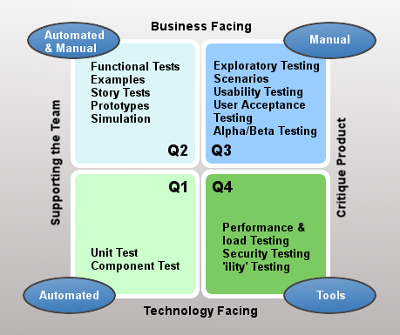
Agile Testing Quadrants

Slide 76
Agile planning techniques
1. Backlog Grooming (Refinement)
Backlog grooming, also known as backlog refinement, is an ongoing process of maintaining and updating the product backlog. The product backlog is a prioritized list of all the work that needs to be done in the project. Grooming ensures that the backlog is:
Appropriately detailed: Items at the top of the backlog (those planned for upcoming sprints) should be more detailed than items further down.
Estimated: Items should have estimates of effort or size.
Prioritized: Items should be ordered based on their value and importance to the product.
Clear and understandable: Items should be written in a clear and concise way so that everyone on the team understands what needs to be done.

Slide 77
Agile planning techniques
Activities in Backlog Grooming:
Creating User Stories: Defining requirements from the user's perspective, typically in the format: "As a [user type], I want [some goal] so that [some reason]."
Splitting User Stories: Breaking down large user stories into smaller, more manageable tasks.
Estimating User Stories: Assigning story points or other estimates to user stories.
Prioritizing User Stories: Ordering user stories based on business value, risk, dependencies, and other factors.
Removing or Updating User Stories: Removing obsolete or irrelevant stories and updating existing stories as needed.

Slide 78
Agile planning techniques
Benefits of Backlog Grooming:
Improved sprint planning: A well-groomed backlog makes sprint planning more efficient and effective.
Better understanding of requirements: Grooming helps the team develop a shared understanding of what needs to be built.
Reduced ambiguity: Clear and detailed user stories minimize confusion and rework.
More accurate estimates: Grooming helps the team provide more accurate estimates of effort.
Increased team alignment: Grooming fosters communication and collaboration among the team.

Slide 79
Agile planning techniques
2. Story Points:
Story points are a unit of estimation used in Agile to express the relative size or complexity of a user story. They are not tied to a specific unit of time (like hours or days). Instead, they represent a relative measure of effort, complexity, and risk.
Why Use Story Points Instead of Time Estimates?
Relative estimation is faster: It's often easier for developers to compare the size of two stories than to estimate the exact time it will take to complete each one.
Avoids the "estimation trap": Time estimates can be perceived as commitments, leading to pressure and potential inaccuracies.
Accounts for complexity and risk: Story points consider not just the amount of work but also the complexity and uncertainty involved.
Promotes team discussion: The process of estimating story points encourages team discussion and shared understanding.

Slide 80
Types of Story Points
Common Story Point Scales:
Fibonacci Sequence (1, 2, 3, 5, 8, 13, 21...): This is the most common scale. The increasing gaps between numbers reflect the increasing uncertainty associated with larger stories.
Linear Scale (1, 2, 3, 4, 5...): A simpler scale that is sometimes used for smaller projects or less experienced teams.
T-Shirt Sizes (XS, S, M, L, XL...): A very high-level estimation technique that can be useful for initial planning.

Slide 81
How to Estimate Story Points
How to Estimate Story Points:
Planning Poker: A popular technique where team members individually estimate story points and then discuss their estimates until they reach a consensus.
Affinity Mapping: A technique where user stories are grouped based on their relative size.

Slide 82
Benefits of Using Story Points
Benefits of Using Story Points:
Improved velocity tracking: Velocity (the number of story points completed per sprint) can be used to forecast how much work the team can complete in future sprints.
Better sprint planning: Story points help the team select an appropriate amount of work for each sprint.
More accurate project forecasting: Velocity can be used to estimate project completion dates.

Slide 83
Lean Software Development
Lean methodology is a process improvement approach focused on maximizing customer value while minimizing waste. It originated in the Toyota Production System (TPS) in the mid-20th century and has since been adopted across various industries, including manufacturing, software development, healthcare, and services.
Core Principles of Lean:
Lean is built upon several key principles:
Value: Define value from the customer's perspective. What are they willing to pay for?
Value Stream: Map the entire process that delivers value to the customer, from start to finish. Identify all the steps involved.
Flow: Ensure a smooth and continuous flow of work through the value stream. Eliminate interruptions, bottlenecks, and delays.
Pull: Produce only what is needed, when it is needed. Avoid overproduction and unnecessary inventory. This is often implemented using a "pull system" where demand triggers production.
Perfection: Continuously strive for improvement by eliminating waste and optimizing the value stream. This is an ongoing process of learning and refinement.

Slide 84
The 8 Wastes (TIMWOOD):
Lean identifies eight types of waste that should be eliminated:
Transportation: Unnecessary movement of materials or information.
Inventory: Excess inventory that ties up capital and resources.
Motion: Unnecessary movement of people.
Waiting: Time spent waiting for materials, information, or decisions.
Overproduction: Producing more than is needed or producing it before it is needed.
Over-Processing: Performing more work than is necessary to create value for the customer.
Defects: Errors or defects that require rework or scrap.
Skills (Non-Utilized Talent): Not effectively using the skills and talents of people.

Slide 85
Lean Tools and Techniques:
Lean employs various tools and techniques to implement its principles, including:
Value Stream Mapping (VSM): A visual tool for mapping the entire value stream.
5S Methodology: A workplace organization method focused on:
  Sort: Eliminate unnecessary items.
  Set in Order: Organize remaining items for efficiency.
  Shine: Clean and maintain the workplace.
  Standardize: Create standards for organization and cleanliness.
  Sustain: Maintain the improvements over time.
Kaizen: Continuous improvement through small, incremental changes.
Kanban: A visual system for managing workflow and limiting work in progress.
Poka-yoke (Mistake Proofing): Designing processes to prevent errors from occurring.
Just-in-Time (JIT): Producing only what is needed, when it is needed.

Slide 86
Benefits of Implementing Lean
Benefits of Implementing Lean:
Increased efficiency and productivity: By eliminating waste and optimizing processes.
Reduced costs: By minimizing inventory, rework, and other forms of waste.
Improved quality: By preventing defects and focusing on customer value.
Faster delivery times: By improving flow and reducing bottlenecks.
Increased customer satisfaction: By delivering more value and meeting customer needs.
Improved employee morale: By empowering employees and involving them in continuous improvement efforts.

Slide 87
Kanban
Kanban is a popular Agile framework used for managing and improving work across human systems. It emphasizes visualization, continuous flow, and limiting work in progress (WIP). Here's how it fits within the Agile world:
Kanban's Core Principles:
Visualize the workflow: Using a Kanban board (physical or digital) to represent the different stages of work.
Limit Work in Progress (WIP): Setting limits on the number of tasks in each stage to improve focus and prevent bottlenecks.
Manage flow: Focusing on optimizing the flow of work through the system to deliver value faster.
Make process policies explicit: Clearly defining the rules and processes governing the workflow.
Improve collaboratively (evolve experimentally): Using feedback loops and data analysis to continuously improve the process.

Slide 88
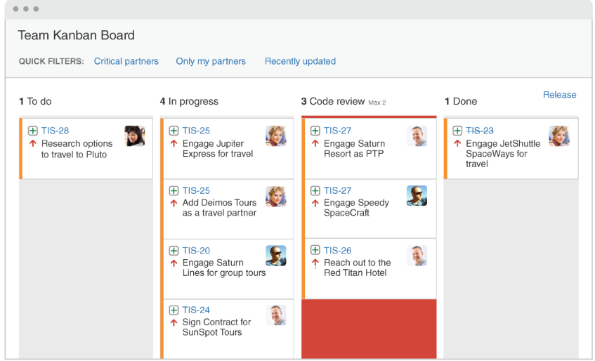
Kanban Boards

Slide 89
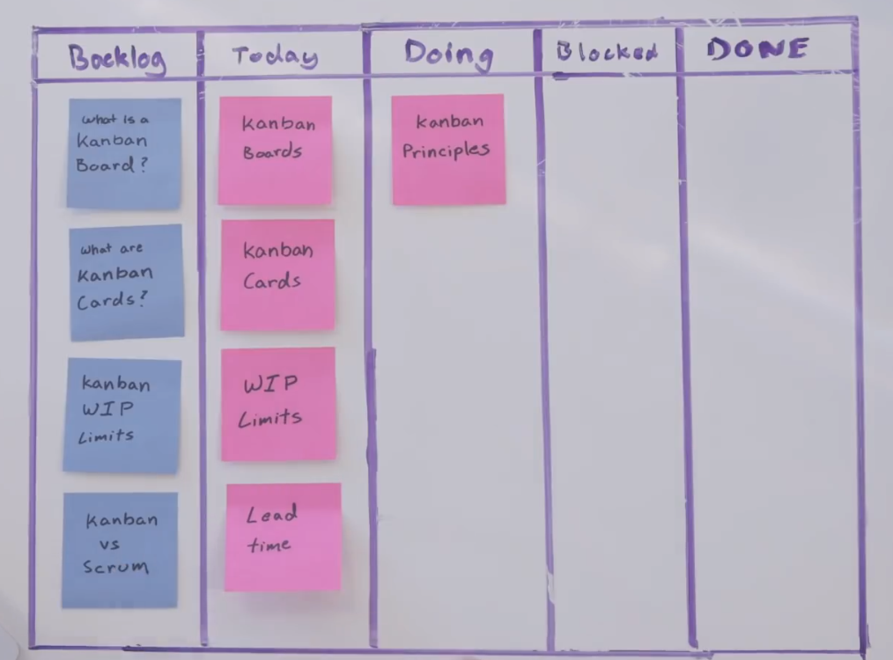
Kanban Boards

Slide 90
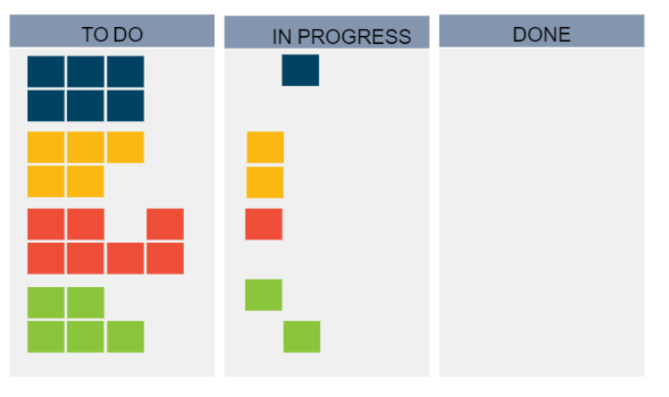
Kanban Boards

Slide 91
Difference Between Kanban and Scrum
Feature | Kanban | Scrum
Roles and Responsibilities | Evolutionary, no prescribed roles or events | Prescribed roles (Scrum Master, Product Owner, Development Team) and events (Sprints, Daily Scrum, Sprint Review, Sprint Retrospective)
Due Dates / Delivery Timelines | Continuous flow, no fixed iterations | Sprints (fixed-length iterations)
Modifications / Changes | Welcomes changes anytime | Changes during the sprint are strongly discouraged. Changes are generally managed between Sprints
Focus | Improving flow and reducing bottlenecks | Delivering potentially shippable increments at the end of each Sprint
WIP Limits | Explicitly limits work in progress | Implicitly limits work through Sprint Backlog
Best Applications | Best for projects with widely-varying priorities. | Best for teams with stable priorities that may not change as much over time.

Slide 92
Extreme Programming (XP)
Extreme Programming (XP), is light weight methodology for small to medium sized teams developing the software in the face of vague or rapidly changing requirements which was described by Kent Beck. It promotes high customer involvement, rapid feedback loops, continuous testing, continuous planning, and close teamwork to deliver working software at very frequent intervals, typically every 1-3 weeks.
The methodology takes its name from the idea that the beneficial elements of traditional software engineering practices are taken to “extreme” levels. As an example, code reviews are considered a beneficial practice. Taken to the extreme, code can be reviewed continuously through the practice of pair programming.
The original XP method is based on four simple values:
  Simplicity
  Communication
  Feedback
  Courage.

Slide 93
When to use XP?
Expect their system’s functionality to change every few months.
Experience constantly changing requirements or work with customers who aren’t sure what they want the system to do.
Want to mitigate project risk, especially around tight deadlines.
Include a small number of programmers (between 2 and 12 is preferable).
Are able to work closely with customers.
Are able to create automated unit and functional tests.

Slide 94
Advantages and Disadvantages
Advantages | Disadvantages
Close contact with the customer | Additional work
No unnecessary programming work | Customer must participate in the process
Stable software through continuous testing | Relatively large time investment
Error avoidance through pair programming | Relatively high costs
No overtime, teams work at their own pace | Requires version management
Changes can be made at short notice | Requires self-discipline to practice
Code is clear and comprehensible at all times

Slide 95
Crystal
The Crystal methodology is one of the most lightweight, adaptable approaches to software development.
Crystal is actually comprised of a family of Agile process models, including Crystal Clear, Crystal Yellow, Crystal Orange and others. Each has unique characteristics driven by several factors, such as team size, system criticality, and project priorities. This Crystal family addresses the realization that each project may require a slightly tailored set of policies, practices, and processes in order to meet the product ‘s unique characteristics.
Introduced by Alistair Cockburn, Crystal focuses primarily on people and the interaction among them while they work on an agile software development project. There is also a focus on business-criticality and business-priority of the system under development.
Unlike traditional development methods, Crystal doesn’t try to fix the tools and techniques of development but keeps people and processes at the core of the process. However, it is not only the people or the processes that are important, rather the interaction between them that is most important.
Several key tenets of Crystal include teamwork, communication, and simplicity, as well as reflection to frequently adjust and improve the process. Like other Agile frameworks, Crystal promotes early, frequent delivery of working software, high user involvement, adaptability, and the removal of bureaucracy or distractions.

Slide 96
Dynamic Systems Development Method (DSDM)
The Dynamic Systems Development Method (DSDM) is an Agile approach that grew out of the need to provide a common industry framework for rapid software delivery. Since 1994, the DSDM methodology has evolved to provide a comprehensive foundation for planning, managing, executing, and scaling Agile process and iterative software development projects.
DSDM is based on eight key principles that direct the team and create a mindset to deliver on time and within budget. These agile principles primarily revolve around business needs/value, active user involvement, empowered teams, frequent delivery, integrated testing, and stakeholder collaboration. DSDM specifically calls out “fitness for business purpose” as the primary criteria for delivery and acceptance of a system, focusing on the useful 80% of the system that can be deployed in 20% of the time.
Compromising any of the following principles undermines the philosophy of DSDM and introduces risk to the successful outcome of the project.

Slide 97
Principles of DSDM
Focus on the business need
Deliver on time
Collaborate
Never compromise quality
Build incrementally from firm foundations
Develop iteratively
Communicate continuously and clearly
Demonstrate control

Slide 98
Feature Driven Development (FDD)
Feature Driven Development is a model-driven, short-iteration process that was built around software engineering best practices such as domain object modelling, developing by feature, and code ownership. The blending of these practices that resulted in a cohesive whole is the best characteristic of FDD.
Feature Driven Development consists of five basic activities:
  Development of an overall model
  Building a feature list
  Planning by feature
  Designing by feature
  Building by feature

